Slide 1
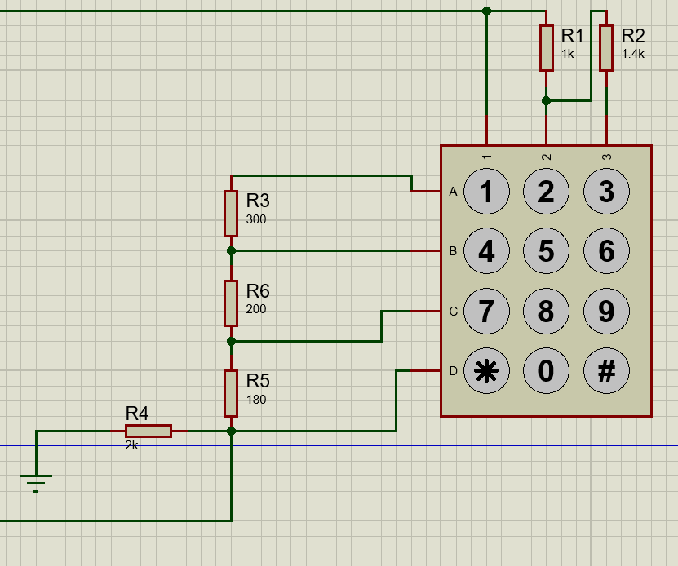
Keypad and connections
To reduce the number of pins, we used resistor-based keypad(Now we use only one pin).
(idea : For pressing every key we get
different resultant resistor combination.)
By practical, we obtain values for each key
pressed.
Get the analog read

Slide 2
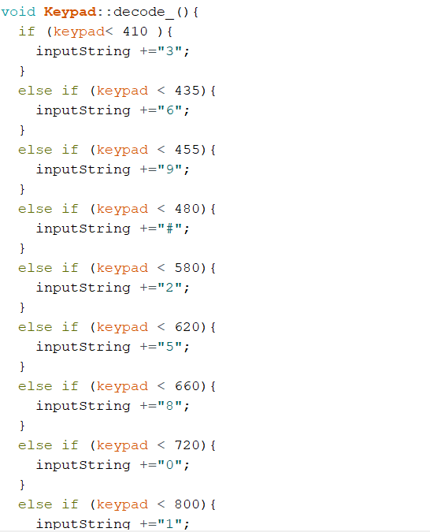
Keypad and connections
Then we create Keypad library.

